Slide 1
BBL - Reactive Streams

Slide 2

What are reactive streams?

Slide 3
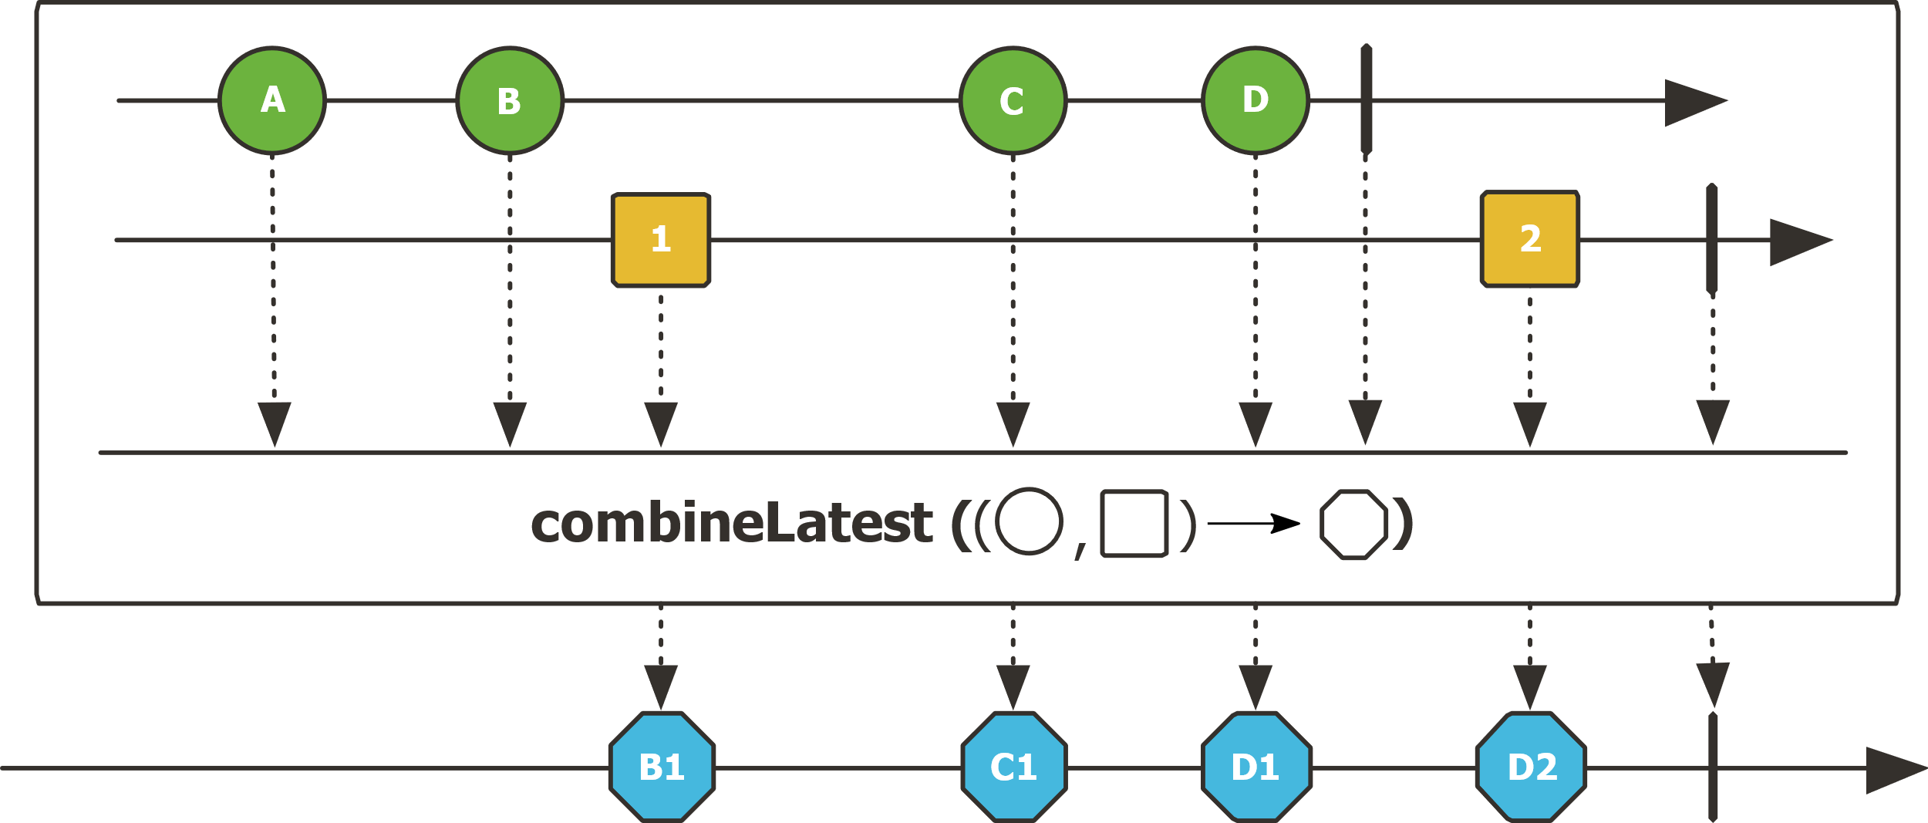
What are reactive streams?

Slide 4
A bit of context
2009 : Reactive Extensions for .NET created by Erik Meijer
«The Observer pattern done right»
For sequences of data, it combines the advantages of iterators with the flexibility of event-based asynchronous programming. It also works as a simple promise, eliminating the pyramid of doom that results from multiple layers of callbacks.
2014: RxJava 1 published by Netflix
September 2014 : The Reactive manifesto
https://www.reactivemanifesto.org/
November 2014 - Reactive Streams «standard»
http://www.reactive-streams.org/
2016: RxJava 2 and Reactor (implementing Reactive Streams)
2017: Flow added in Java 9 (no implementation)

Slide 5
Reactive Streams: a clear specification
Publisher
Subscriber
Subscription
Processor (Subscriber & Publisher)
The specification defines the semantic of these types, for example how a subscriber requests values from a publisher, backpressure, etc.
RxJava 2, Reactor, Akka… implement this spec and add their own functions on these types.

Slide 6
DEMO

Slide 7
Main problems
Learning curve
Debugging
Overdoing it

Slide 8
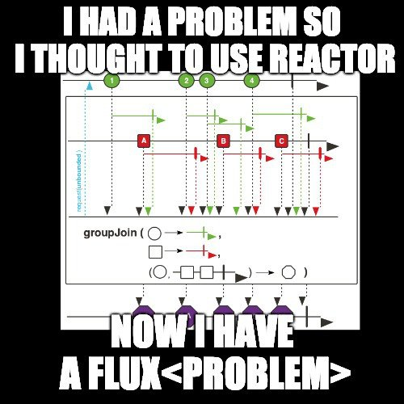
Main problems

Slide 9
The future
Reactive DB drivers – R2DBC
RSocket: end to end reactive streams over the network
Multiple transports: TCP, HTTP2, Aeron
Session resumption (mobile)
No more sidecars
Service discovery
Security
Monitoring
Load balancing
Backpressure -> no need for circuit breakers

Slide 10
LINKS
Reactive Streams spec:
http://www.reactive-streams.org/
Reactor’s documentation
https://projectreactor.io/docs/core/release/reference/#intro-reactive
Reactive Extensions (all languages): http://reactivex.io/
Good book on RxJava (all the concepts apply to other reactive streams implementations)
https://www.amazon.com/Reactive-Programming-RxJava-Asynchronous-Applications-ebook/dp/B01LZQGIIC
RSocket
http://rsocket.io/
http://rsocket.io/docs/Motivations
Presentation: https://www.infoq.com/presentations/messaging-architecture-future?utm_campaign=infoq_content&utm_source=twitter&utm_medium=feed&utm_term=architecture-design
https://www.netifi.com/proteus
R2DBC
https://r2dbc.io/

